Slide 1
Bank CRM Analysis

Slide 2
Problem statement
You are an analytical CRM (Customer Relationship Management) specialist hired by a bank to extract meaningful insights from various customer-related datasets. The bank aims to reduce customer churn, improve service delivery, and enhance customer satisfaction. They have provided you with datasets including customer demographics, transaction details, customer exit information, and active customer profiles.

Slide 3
Data description
activecustomer:
ActiveID: 0 and 1, unique identifier
ActiveCategory: Corresponding category like Active Member for 1 and Inactive Member for 0
Bank_churn:
CustomerID: Unique identifier assigned to each customer.
CreditScore: Credit Score each customer has.
Tenure: The number of years the customer has been with the bank.
Balance: Current balance in the customer's account.
NumOfProducts: refers to the number of products that a customer has purchased through the bank.
HasCrCard: denotes whether or not a customer has a credit card. This column is also relevant, since people with a credit card are less likely to leave the bank.
IsActiveMember: active customers are less likely to leave the bank (as per the criteria defined by the bank for identifying the activeness).
Exited: whether or not the customer left the bank.
creditcard:
CreditID: 0 and 1, unique identifier
Category: Corresponding category like ‘credit card holder’ for 1 and ‘non credit card holder’ for 0
exitcustomer:
ExitID: 0 and 1, unique identifier
ExitCategory: Corresponding category like ‘Exit’ for 1 and ‘Retain’ for 0

Slide 4
Data description
gender:
GenderID: 1 and 2, unique identifier
GenderCategory: Corresponding category like Male for 1 and Female for 2
customerinfo:
CustomerId: Unique identifier assigned to each customer.
Surname: Last name of each customer.
Age: Age of each customer in years.
GenderID: Id depicting whether person is male or female.
EstimatedSalary: Denotes the Average Salary of each Customer
GeographyID: ID denoting from which location the customer is.
Bank DOJ: Date of Joining of Bank
geography:
GeographyID:1, 2 and 3, unique identifier
GeographyLocation: 1 for France, 2 for Spain and 3 for Germany

Slide 5
Methodology
1. Data Preprocessing and Data Cleaning
There is no missing or error data present in the Data Set.
Changed the Datatypes of “Balance” column to Currency in bank_churn table, “Bank DOJ” column to Date type and “EstimatedSalary” column to Currency in customerinfo table.
2. Data Modelling
Using the Model view of Power BI, created the model by connecting and establishing relationships between tables.
3. Data Engineering and Data Analysis
Using DAX functions created various calculated columns like BalanceSegement, CreditScore Segment etc and various calculated measures like total customers, total balance etc.
For Data Analysis, created KPIs like Churn Rate, Average Balance, Total Customers, Average Salary and Average Credit Score. Created various charts segregated all over 6 page report. Created Parameters for Dynamic Chart Visualizations.

Slide 6
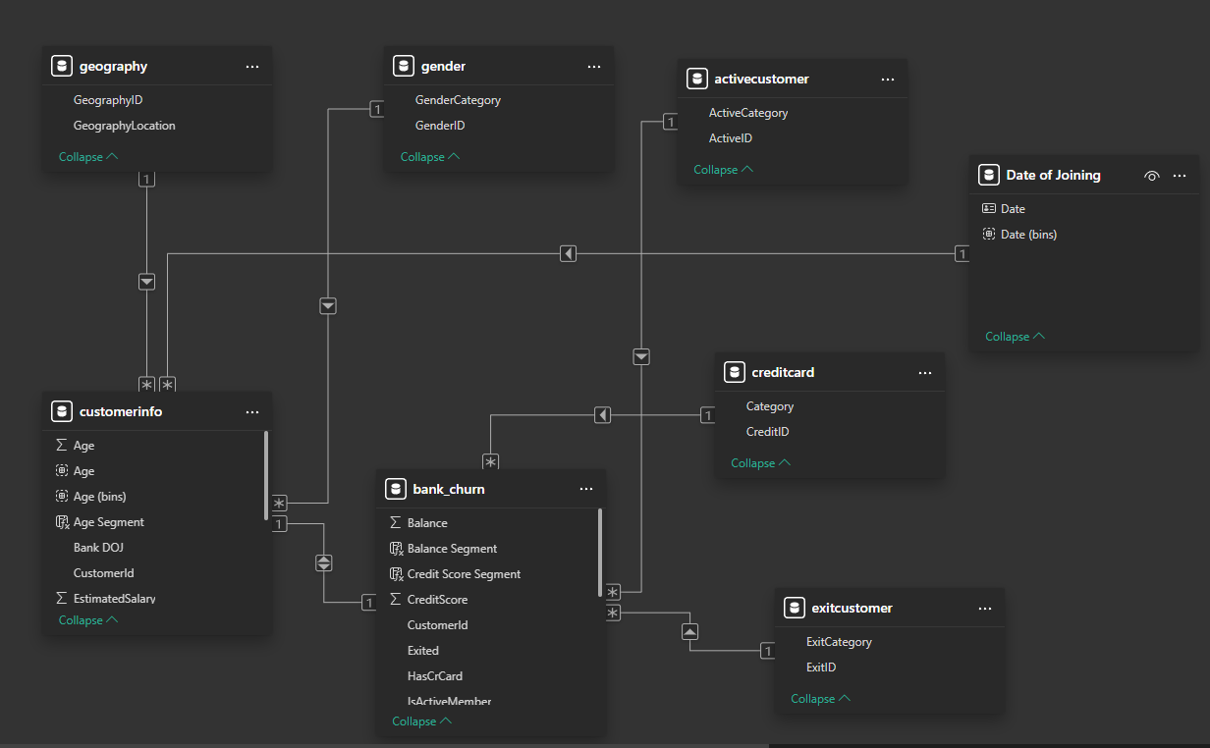
Model

Slide 7
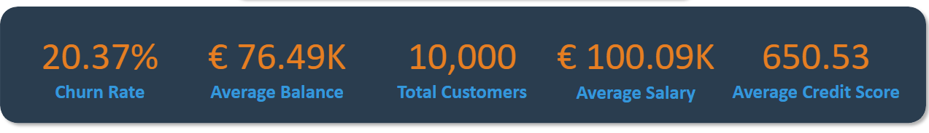




Key Performance Indicators

Slide 8
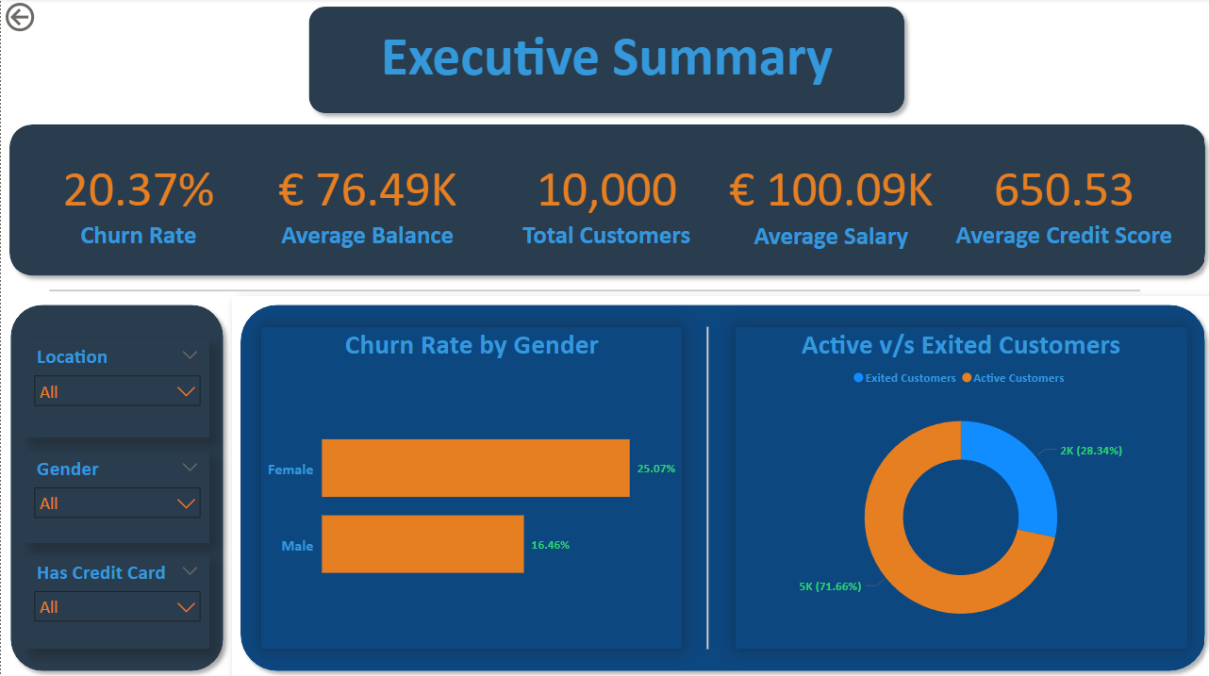
Executive Summary

Slide 9
Executive Summary
This is an Executive level Summary which give Higher Level details to the Bank’s Executives to have look on various KPIs and general overlook on data.
Analysis Points :-
Churn Rate looks on lower side with the value of “20.37%”. Germany has high churn rate almost double to other locations like France and Spain. Females have high rate as compare to males.
Average Balance is “76.49K” with the Average Salary of “100.09K” is pretty good since we have data of only 1000 Customers. Even the Average Credit Score “650.53” is High enough to predict that Customers still have enough money to pay their bills.
Active customers(71.66%) are way more than Exited Customers(28.34%), means Customers still trusts the bank.

Slide 10
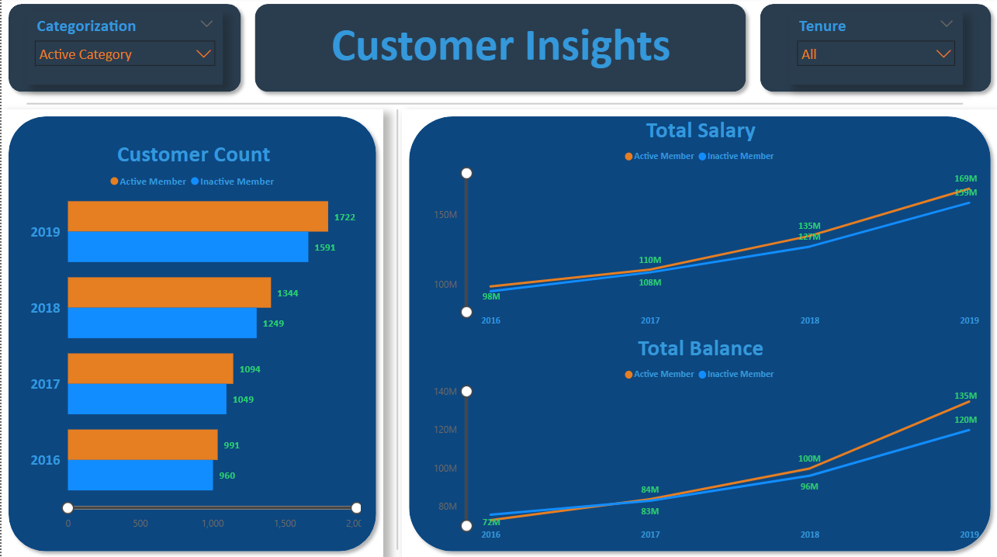
Customer Insights Analysis

Slide 11
Customer Insights Analysis
In this page I analysed how Customer count, their Salary and Balance varies over years and Tenure.
In Active Categorization :-
From 2016 to 2019 all the various measures increased for Active Customers showing Optimal Credit Card Usage and faith in bank. This also shows that Bank has picked right customers with good Credit Score who can pay their bills.
Location Categorization
France always tops the Customer count with Germany and Spain having almost similar customer counts.
France also tops in Total Salary and Balance domain, whereas Spain and Germany are almost similar in Total Salary and France and Germany are almost similar in Total Balance.

Slide 12
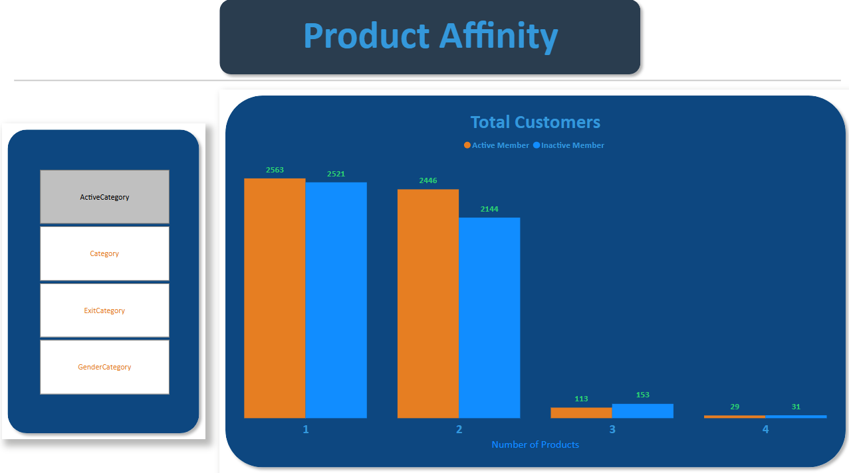
Product Affinity Analysis

Slide 13
Product Affinity Analysis
Since the Data about the Products was not given but how many products customer purchased is given based on that I have done the Analysis of Customer Count in various categories like Active Customer Category, Exited Customer Category etc.
In Active Customers Category
As the number of products purchased increased, active customers go down.
In Credit Card Category
Customers purchasing more products have less chances they will opt for credit card services.
In Exited Category
Customers buying more than 2 products, there total count is less but most of them exited from the services of bank.
According to Gender wise counts
Up to 2 number of products male customers are more but after that overall customers decline highly and in that females percentage is more than males.

Slide 14
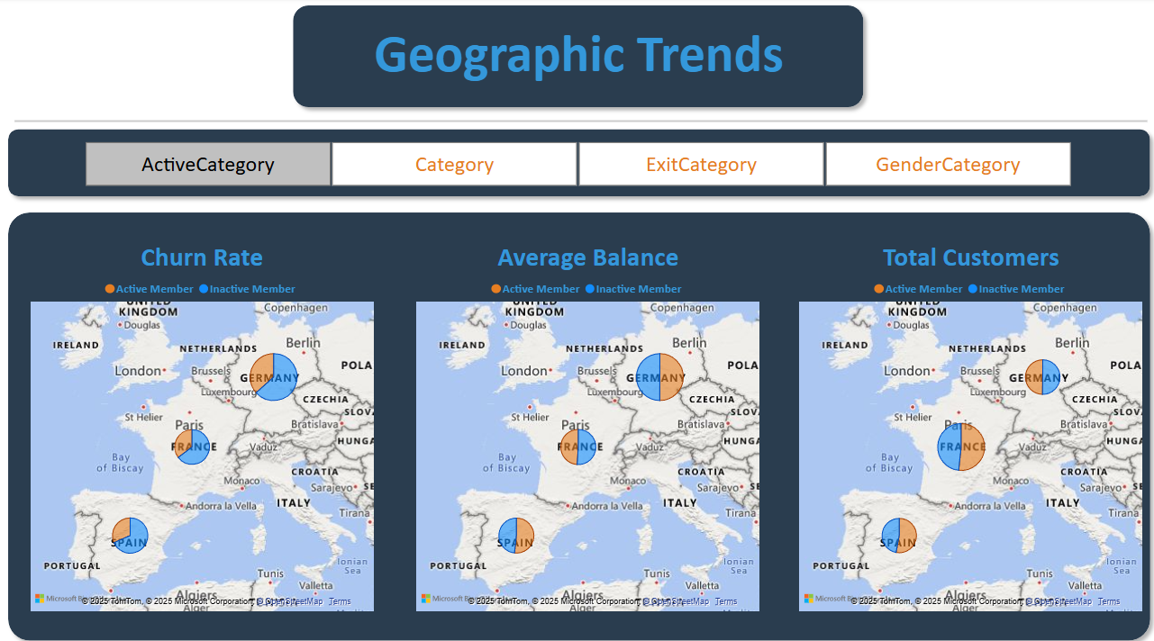
Geographic Trends Analysis

Slide 15
Geographic Trends Analysis
In this I have analysed Churn Rate, Average Balance and Total Customers distribution in different categories
Active/Inactive Members
Inactive members have higher churn rate in all three countries, with almost same average balance and total customers distribution. Most of the customers are from France, but Germany tops in other two.
2. Credit/Non-Credit Card Holder
In Churn rate and Average Balance, Germany tops and all three countries have almost equal sharing. But in Total customers France tops and there are more credit card holders in all countries combined than non ones.
3. Gender
Females tend to higher churn rate than males but males have higher count and Average balance.

Slide 16
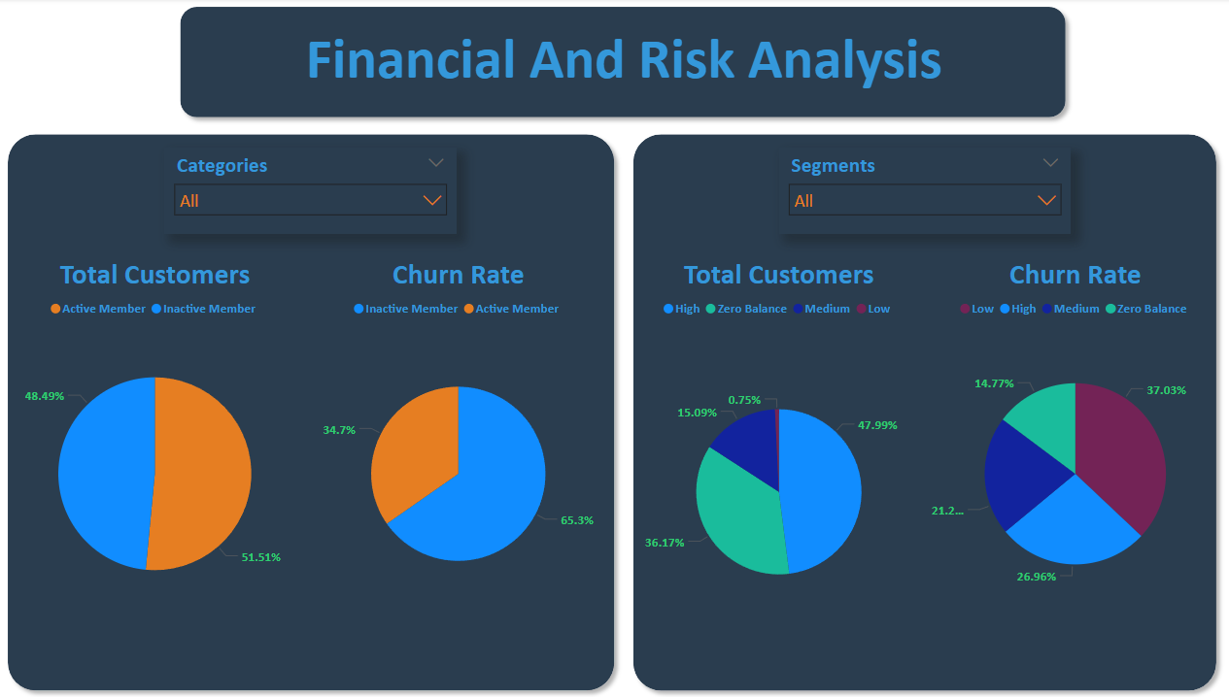
Financial and Risk Analysis

Slide 17
Financial and Risk Analysis
In this I have analysed Churn Rate and Total Customers distribution in different categories and segments
Active/Inactive Members
Inactive members have higher churn rate but there are more number of active members.
2. Credit/Non-Credit Card Holder
Credit card holders are more and their churn rate is slightly less than non credit card holder people.
3. Exit/Retained
Exited customers obviously has 100% churn rate but overall only 20.37% people exited.
4. Balance Segment
There are very little customers in Low Balance Segment and their Churn rate is also the highest.
5. Credit Score Segment
Similar to Balance Segment, very low percentage of customers have Poor Credit Score and their Churn Rate is also highest.
6. Age Segment
Customers with age more than 50 have High Churn rate.

Slide 18
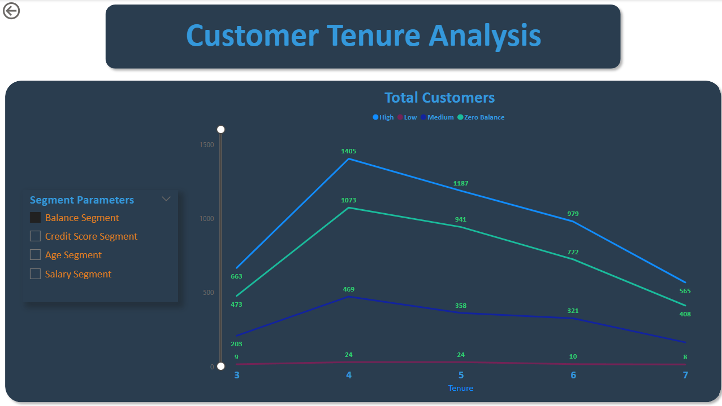
Customer Tenure Analysis

Slide 19
Customer Tenure Analysis
In this I have analysed Total Customer count in different Segments over tenure
Balance Segment
As the Tenure increases, total customer count decreases in every Balance Segment
2. Credit Score Segment
Same as previous Segment Credit score decreases over longer Tenures
3. Age Segment
Younger and Older people have almost similar line showing their financial instability. Middle age people are way more above than these two segments
4. Salary Segment
Low and Medium Salary customers have almost similar graph
But overall customer count decreases as tenure increases

Slide 20
Recommendation
Since the Churn rate is not very bad and Bank is able to retain most of it’s customers, so overall it is doing Good.
They need to expand beyond three locations also for more opportunities.
They need to make sure what is causing the decline in customers who opted more than 4 years tenure with bank. May be this is due bad customer service.
To maintain confidence in Customers, they need to start campaigning their products and services and also need to focus on what additional benefits they can provide on their Credit Cards.
For younger and Older customers they can start some programs and loan services to help them with the career for youngers and better life for the olders.
They also need create some strategy to attract people with high incomes like SIPs and other kind of Investment plans.

Slide 21
Conclusion
As world is moving towards more to Digitalisation and AI, Banks need to understand that how these technologies can help them to grow. We all know that these things comes at security risks but they work faster then humans can solve problems quickly through Analysis and Forecasting. Social Media also helps banks to grow globally and helps them to reach out more customer segments that they have never reached before.

Slide 22


